Slide 1
Links
Singleton
Factory
Abstract Factory
State
Strategy
Façade
Adapter
Bridge
Observer
Iterator
Proxy
Flyweight
Decorator
Mediator
Assignment Details
SOLID
Design Pattern Types
Enumerating Cases
Layering

Slide 2
Design Patterns

Slide 3
How I will present each design Pattern
Discuss Prerequisites of learning this pattern.
Discuss the code problems this design pattern is intended to help solve.
Define the pattern including the original Gang of Four definition and UML
Discuss how this pattern helps achieve SOLID software development principles.
Discuss real-world scenarios where you would use this design pattern.
An implementation of one of these real-world scenarios.

Slide 4
Week 2
Singelton and Factory Patterns

Slide 5
Singleton Design Pattern
Your first pattern

Slide 6
Singleton Prerequisite
IOC Container

Slide 7
What is an IOC container
An IOC container is a way to resolve dependency trees when using Dependency Inversion.
Because dependency inversion requires a lot of instantiation of classes and IOC container can help you resolve an entire dependency tree.
IOC containers allow you to register an Interface with the constructor of a concrete object then whenever a implementation is needed you resolve your dependencies and as long as all the objects are registered it will resolve the whole dependency tree.
IOC containers help a system be more open closed by relying on abstractions rather than concrete classes.
It also makes Dependency Inversion much easier.
Finally It allows singleton objects to not need static methods improving testability.

Slide 8
IOC and Singleton
We will still teach how to implement a normal singleton pattern.
IOC containers can however provide the same functionality without having to implement singleton from scratch.
The demos we will use will implement it both ways.

Slide 9
Singleton Defined

Slide 10
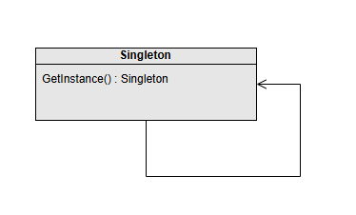
Gang of Four Definition
“Ensure a class has only one instance and provide a global point of access to it.”

Slide 11
Attributes of a singleton
A singleton is a class that controls its own instantiation.
A singleton can only create an instance of itself through a static constructor.
The first time a singleton’s constructor is invoked it creates a new instance of that class.
Subsequent invocations of the constructor return the same instance created in the first invocation.

Slide 12
Benefits of a Singelton Pattern
A singleton object is only created once (avoiding the expense of creating a class multiple times).
A singleton object always acts the same way anywhere in the system and contain the same data.
A singleton can share data across large systems.

Slide 13
Down sides of Singelton
Its default form breaks the single responsibility principle.
In multi-threaded programs singleton may react inconsistently.
Static Methods are difficult to test.
Objects can become too bloated.
Does not release memory as efficiently.

Slide 14
Relationship to Solid
Singleton

Slide 15
Singletons need help with SOLID
Some consider Singelton an Anti-Pattern (A pattern that makes things worse not better).
Because Singletons both manage their creation and their state plus do whatever the singleton object is supposed to do it technically breaks single responsibility.
Because singletons are static in nature they are difficult to pass around making it difficult to achieve Open Closed as well as Dependency Inversion.
However there is hope. With an IOC container you can implement singleton functionality while maintaining all of the solid principles. Through IOC you can have all of the upside with less of the downside.

Slide 16
Real World Scenarios

Slide 17
What are some Scenarios where Singletons Might be Useful?

Slide 18
Scenarios where Singletons are often Used
IOC containers themselves
Loggers
Configuration Management
Game State Management (Avoid the GOD class)

Slide 19
Implementation
Singelton

Slide 20
Implementing a Singelton in Code

Slide 21
Implementing a Singleton using IOC
Using Unity

Slide 22
Factory Design Pattern
Making stuff with the things

Slide 23
Factory problem space

Slide 24
What problems do factory methods Help Solve?
Not knowing what object implementations you will need ahead of time.
Implementing complex conditional logic.

Slide 25
Factory Defined

Slide 26
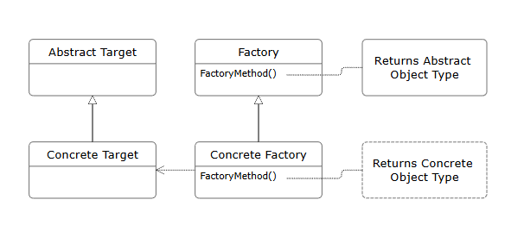
Gang of Four Definition
“Define an interface for creating an object, but let subclasses decide which class to instantiate. Factory method lets a class defer instantiation to subclasses.”

Slide 27
Attributes of a factory
Encapsulation of Object Creation : Hides the details of instantiating Objects making code more modular.
Interface – Based Design
Reusability : Allow us to reuse complex creation code across applications.
Polymorphism : Supports polymorphism by returning different subclasses of common classes.
Scalability : New types can easily be added.

Slide 28
Benefits of a Factory Pattern
Enhances Maintainability : Because it encapsulates instantiation logic so that the only place instantiation logic needs to change is in the factory.
Supports Loose Coupling : The client code depends on abstractions facilitating loose coupling.
Improves Testability : Allows mocking and ease of testing individual components.

Slide 29
Down sides of A factory
Increases the Complexity: By adding a layer of abstraction you also add complexity. (KISS) (YAGNI)
Less transparency on how objects are created and instantiated.
Reduced Performance
Factories themselves are tightly coupled to the objects they create even though they promote loose coupling in the objects themselves.

Slide 30
Relationship to Solid
Factory

Slide 31
Factory Method and S.O.L.I.D.
S. Factory promotes single responsibility by separating the creation logic from the class logic.
O. Because factories depend on abstractions extension is easier and modification though necessary in the factory itself is reduced in the implemented classes.
L. Factories control what kind of classes are created and although it doesn’t prevent violations of Liskov It does promote it.
I. Factories are based on interfaces. Again this does not prevent abuse of this principle but it does not hinder it either.
D. Factories can be used in IOC containers to instantiate objects. It actually promotes even better use of IOC containers and presents abstractions so that dependency inversion can occur. I can even act in some ways like an IoC Container by removing the complexity of many layers of dependency.

Slide 32
Real World Scenarios
Factory

Slide 33
What are some Scenarios where factories Might be Useful?

Slide 34
Scenarios where Factories are often Used
Anywhere you are working with Interfaces or Abstract classes with multiple implementations.
Decoupling Client code from specific OS or other dependencies. (Have a single application that works on both Windows and Mac where you want to take advantage of OS specific functionality)
Whenever the creation of an object is complex (IE multiple dependencies)
When selecting the instance type of a class is complex.

Slide 35
Implementation
Factory

Slide 36
Implementing a Factory in Code

Slide 37
Abstract Factory Design Pattern
Make all the stuff with the things

Slide 38
Abstract Factory problem space

Slide 39
What problems does Abstract factory Help Solve
How can I use the same single object throughout my entire application?

Slide 40
Gang of Four Definition
“An interface for creating families of related or dependent objects without specifying their concrete classes”

Slide 41
Attributes of an abstract factory
Abstract Factory: Declares creation methods for product families.
Concrete Factory: Implements creation methods.
Products: Abstract product interfaces and concrete product classes.

Slide 42
Benefits of an abstract Factory Pattern
Consistency: Ensures all objects in a family adhere to the same structure.
Flexibility: Simplifies switching between different families of objects.
Scalability: Facilitates adding new families without altering existing code.
Code Reuse: Encourages modular and reusable design by separating object creation

Slide 43
Down sides of An abstract factory
Complexity: Adds extra layers of abstraction and increases initial development effort.
Rigidity: Can be challenging to introduce new products into existing families.
Overhead: May lead to unnecessary complexity if the application doesn’t require multiple product families.

Slide 44
What are some Scenarios where abstract factories Might be Useful?

Slide 45
Scenarios where abstract Factories are often Used
IOC containers themselves
Loggers
Configuration Management
Game State Management (Avoid the GOD class)

Slide 46
Relationship to Solid
Abstract factory

Slide 47
Factory Method and S.O.L.I.D.
Single Responsibility Principle (SRP):
Encapsulates object creation within dedicated factory classes, simplifying code maintenance.
Open/Closed Principle (OCP):
Abstract factories can be extended to support new object families without modifying existing code.
Liskov Substitution Principle (LSP):
Product abstractions ensure that any derived class can replace its base class without issues.
Interface Segregation Principle (ISP):
Defines specific interfaces for product families to avoid bloated and irrelevant methods.
Dependency Inversion Principle (DIP):
High-level modules depend on abstractions, not concrete implementations, promoting flexibility.

Slide 48
Real World Scenarios
Abstract Factory

Slide 49
Implementation
Abstract Factory

Slide 50
Implementing an abstract factory in Code

Slide 51
Week 3
Case Enumeration / Commonality Variability / State Design pattern

Slide 52
Enumerating Cases
Commonality Variability Analysis and other approaches

Slide 53
Commonality Variability Analysis

Slide 54
What is Commonality Variablity Analysis

Slide 55
How do we Apply Commonality Variability Analysis
Establish the Scope
Identify Commonalities and Variabilities
Bound the Variabilities
Exploit the Commonalities
Accommodate the variabilities

Slide 56
Commonality Variability with Magic
We will be doing a commonality variability study with Magic the Gathering Cards.
Don’t worry if you don’t play magic it dosen’t matter.
People who play magic or other card games may be able to find additional commonalities and variability but that is not the point. The point is to look at what you have and do this to the best of your ability based on what is in front of you.
I will put up an anatomy of a magic card up on the board so that you can see what things mean on the cards but again finding the obvious commonalities and variability in the cards is what is important.
You will have 15 cards to start with. Apply these principles to your starting cards.
Do not worry about doing damage to these cards they will be tossed after class or you can keep them whatever.
I put sleves on them not to product them but so you can use dry erase markers to write on them and erase if you want to.

Slide 57
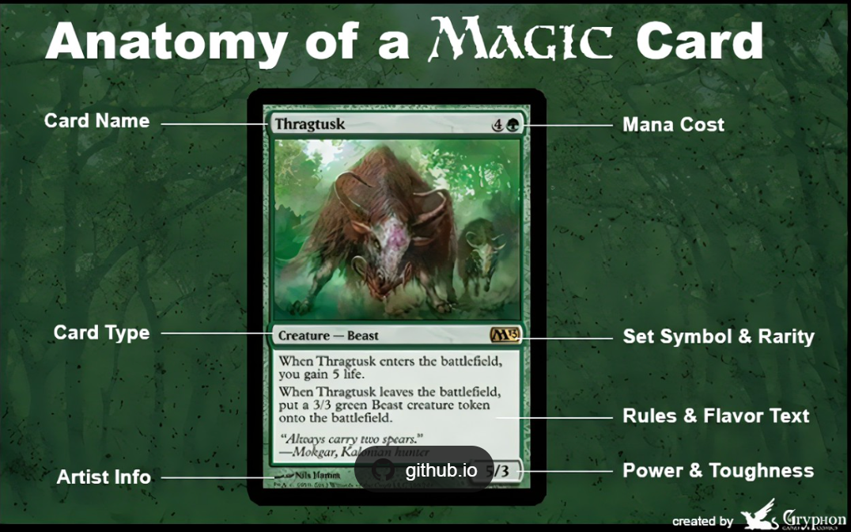

Slide 58
Initial assessment (5 Min)
Each of you has a magic card.
Look at your magic card and at the top of an index card (one card per attribute) list as many attributes as you can of the card you are looking at.

Slide 59
Establish the Scope Take 10 Min
Now as a team look at all the cards your team has.
Try and discover what the full scope of the cards you have include.
As a help magic only has 5 main colors you can see the colors represented as dots on the back of the cards.
Cards can also be colorless.
Outside of that established scope see what you can make of any other scope and looking at the cards you have eliminate any things you don’t believe are pratical changes that could be made.
Write the elements of this scope on a single index card.
ALL THE CARDS YOU HAVE MUST BE IN SCOPE. (IE none of them can break the parameters of your scope)
Determine at least 3 other things you will not allow within your scope or must exist to be included within your scope.

Slide 60
Identify Commonalities / Variablities Setup (15 MIN)
Take all the cards you created when you were doing your individual initial assesments.
Compare those cards to all the cards others created.
Throw away any duplicate attribute cards or combine similar concepts into one card.
Once you have gotten rid of extra cards come up with any additional attributes any of the cards you now know about have.
You should get more general (They all Have a color, They all have a Name)
You should also get more specific (Some cards are sorcery cards)

Slide 61
Determine what cards fit in which group (15 Min)
You may want to number each of the individual cards to make this easier.
For the next 15 min Grab a card from your pile of attributes and then go through each magic card card (It may help to have each person have a subset of cards) If that card fits into that group write the name or number of that card on your index card.
Keep doing this for each index card.
If you run out of index cards figure out if there are attributes you are missing. Make those cards and continue this activity with those cards as you make them.

Slide 62
Bound the Variabilites (10 Min)
Put your scope card front and center so everyone can see it.
For the next 10 minutes do the following
Look at the variability cards you have.
For each card as a group decide what the boundaries you want to place on that variability are.
To do this the boundries.
Can not cause you to exclude any card that do not fit in to this variability.
Must account for all the cards that do exist within this variability.
Clearly define what does and does not fix in to this variation.

Slide 63
Exploit the Commonalities (On a white board Psudeo Code)
For the next 10 minutes look at all of the commonalities your card have.
Create an interface (Or set of interfaces remember single responsibility and interface segregation) design that lists all of the properties that all the cards have in common.
Create a Card Class that inherits all of these interfaces.

Slide 64
Accommodate for the Variabilities (10 Min)

Slide 65
State Design Pattern
Dude where am I

Slide 66
State problem space

Slide 67
What problems does State Pattern Help Solve?
Creating a family of algorithms.

Slide 68
State Pattern Defined

Slide 69
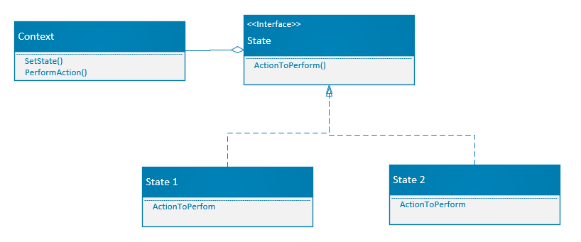
Definition
“Allow an object to alter its behavior when its internal state changes. The object will appear to change its class.”

Slide 70
Attributes of a State Design Pattern
Context: Maintains a reference to a State object representing the current state.
State Interface/Abstract Class: Defines a common interface for all concrete states.
ConcreteState Classes: Implement state-specific behavior for each state.

Slide 71
Benefits of a State Design Pattern
Modularity: Encapsulates state-specific behavior in separate classes.
Simplicity: Eliminates large conditional statements in the Context.
Extensibility: Easy to add new states without modifying Context.
Explicit Transitions: State changes are clear and controlled.
.

Slide 72
Down sides of A State Design Pattern
Increased Classes: Each state requires a ConcreteState class.
Complexity: May overcomplicate simple state-dependent behavior.

Slide 73
Relationship to Solid
State

Slide 74
State pattern and S.O.L.I.D.
S. Each Concrete class has a single responsibility (To handle the behavior for a specific state)
O. State Pattern is open to extension (by adding new concrete classes) and closed to modification by not necessitating changing other classes to implement the new state.
L. States must be interchangeable for one another because they fully must represent their individual state.
I. The state interface requires an interface that only does what is required to handle the state and not force having nonessential functionality.
D. State can be injected into context and context is dependent on the interface not the concrete class.

Slide 75
Real World Scenarios
State pattern

Slide 76
What are some Scenarios where The State Pattern Might be Useful?

Slide 77
Scenarios where The State pattern is often Used
Use when behavior depends on state and must change dynamically.
Ideal for replacing complex state-based conditionals with polymorphism.
Vending Machines
Order Processing
Traffic Light
Game Characters

Slide 78
Implementation
State Pattern

Slide 79
Implementing a State Pattern in Code

Slide 80
Week 4
Layering/ Valuable Abstractions/ Strategy Design pattern

Slide 81
Layering
I Like Pancakes

Slide 82


Architecture Layers
Presentation Layer
Business Logic Layer
Data Access Layer
Database Layer

Slide 83
Software Design Patterns
Model – View – Controller (MVC)
Layered Architecture Pattern

Slide 84
Network Protocol Layers
Application Layer
Transport Layer
Network Layer
Data Link Layer
Physical Layer

Slide 85
Operating System Layers
User Space
Kernal Space
Hardware Abstraction Layer

Slide 86
Security Layers
Perimeter Security
Network Security
Application Security
Data Security

Slide 87
Development Process Layers
Requirement Analysis
Design
Implementation
Testing
Deployment
Maintenance

Slide 88
Virtualization Layers
Hypervisor
Guest OS Layer
Application Layer

Slide 89
Microservices Architecture
Service Layer
API Gateway Layer

Slide 90
Cloud Computing Layers
Infrastructure as a Service
Platform as a service
Software as a Service

Slide 91
Why so many Layers in Software?
Separation of Concerns
Modularity
Isolation
Maintainability
Ease of Updates
Simplified Debugging
Scalability
Reusability
Component Reuse
Service Reuse
Flexibility
Interchangeability between Layers

Slide 92
Layering and S.O.L.I.D.
S. Just like classes layers should have single responsibilities.
O. Layered code can bet extended to provide new functionality without needing to modify existing code.
L. This principle is still applicable at software layer levels.
I. Interfaces at the layer level should expose just what they need just like classes.
D. Higher layer levels should not depend on lower level layers. UI logic should not depend on business and business should not depend on data for example.

Slide 93
Using Layers throughout your Code
Create a console application.
Put all the necessary code in the console app to read some text from a text file.
Then take that text and transform it in any way you wish.
Then have it write to the console.

Slide 94
STRATEGY Design Pattern
Making stuff with the things

Slide 95
STRATEGY problem space

Slide 96
What problems does STRATEGY Pattern Help Solve?
Implementing Complex Business Logic
Creating a family of related algorithms

Slide 97
Strategy Pattern Defined

Slide 98
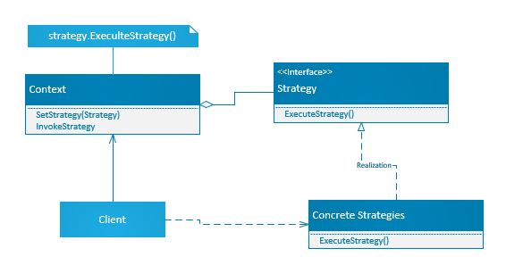
Gang of Four Definition
“Define a family of algorithms encapsulate each one and make them interchangeable. Strategy lets the algorithm vary independently from clients that use it.”

Slide 99
Attributes of a Strategy Design Pattern
There is a strategy interface the defines the action method.
Multiple concrete strategies (Implementations)
There is a strategy context which encapsulates the strategy interface
The context allows the calling code to set its internal strategy field to a concrete implementation
The concrete strategy implementation is set on the context based on some conditional logic

Slide 100
Benefits of a Strategy Design Pattern
Reduces complex conditional logic from the code because each type of behavior is handled by it’s own strategy
Easily swap algorithms at runtime
Because the context retains I’s strategy you don’t have to execute conditional logic regularly
.

Slide 101
Down sides of A State Design Pattern
Most languages provide method delegation and in many cases this may be a more appropriate implementation to solve this problem.
May overcomplicate behavior.

Slide 102
Relationship to Solid
State

Slide 103
Strategy pattern and S.O.L.I.D.
S. Each Concrete class has a single responsibility (To handle the behavior for a specific strategy)
O. Strategy Pattern is open to extension (by adding new concrete classes) and closed to modification by not necessitating changing other classes to implement the new strategy.
L. Concrete Strategies must be interchangeable for one another because they fully must represent the strategy interface.
I. The Strategy interface requires an interface that only does what is required to handle the strategy involved and not force having nonessential functionality.
D. The strategy can be injected into context and context is dependent on the interface not the concrete class.

Slide 104
Real World Scenarios
Strategy pattern

Slide 105
What are some Scenarios where The Strategy Pattern Might be Useful?

Slide 106
Scenarios where The Strategy pattern is often Used
Payment Processing Systems
Data Encryption
Sorting
File Compression
Authentication

Slide 107
Haven’t I seen this somewhere before?
This is just a state pattern right?

Slide 108
Difference between State and Strategy
State
Strategy
Changes the object’s behavior based on its internal state.
Varies based on when the state of the application changes.
Concrete classes represent a full state.
Changes based on client selection.
Varies when choosing a specific strategy at a specific time in execution.
Concrete classes represent a different strategy for solving a problem.

Slide 109
Implementation
Strategy Pattern

Slide 110
Implementing a Strategy Pattern in Code

Slide 111
Week 5
Review/ Practice / Facade Design pattern/Adapter Design Pattern

Slide 112
Facade Design Pattern
Push all your Dirty Clothes in the Closet

Slide 113
Facade problem space

Slide 114
What problems does Facade Pattern Help Solve?
Accessing complex back-end logic from the presentation layer.
User Interface and the backend logic are developed separately

Slide 115
Facade Pattern Defined

Slide 116
Gang of Four Definition
“Provide a unified interface to a set of interfaces in a subsystem. Façade defines a high-level interface that makes the subsystem easier to use.”

Slide 117
Attributes of a Facade Design Pattern
The Façade
Subsystem Classes
Interfaces (To Sub Systems)

Slide 118
Benefits of a Facade Design Pattern
Hides Internal Complexity
Handles translation to subsystems when necessary
Coordinates relationships between multiple subsystems when necessary
Makes it easier to use complex subsystems individually or together.

Slide 119
Down sides of A Facade Design Pattern
I often has a god complex. It is very easy to turn the façade into a god object.

Slide 120
Relationship to Solid
Facade

Slide 121
Facade pattern and S.O.L.I.D.
S. Façade has a very difficult relationship with Single Responsibility. It can be done but you must be very careful with this.
O. It is very open closed. Everything behind the façade can freely be changed out without affecting anything in front of the façade.
L. In order for a façade to work the backend switched out need to meet Leskov's
I. The Façade Interface should be separated into individual pieces that represent smaller elements of a larger program.
D. Facades can be injected into other classes to simplify the consumption of more complex code.

Slide 122
Real World Scenarios
Facade pattern

Slide 123
What are some Scenarios where The Facade Pattern Might be Useful?

Slide 124
Scenarios where The Facade pattern is often Used
Ecommerce Platforms
Home Automation
Banking Systems
Enterprise Applications
Game Development (Think Unity)
Web Development (the C in MVC may be considered a façade)

Slide 125
Implementation
Facade Pattern

Slide 126
Implementing a Facade Pattern in Code

Slide 127
Adapter Design Pattern
Making things look like other things

Slide 128
Adapter problem space

Slide 129
What problems does Adapter Pattern Help Solve?
Third party components are not compatible with your code.

Slide 130
Adapter Pattern Defined

Slide 131
Gang of Four Definition
“Convert the interface of a class into another interface clients expect. Adapter lets classes work together that couldn’t otherwise because of incompatible interfaces.”

Slide 132
Attributes of aN Adapter Design Pattern
Target Interface : What the client expectes
Adaptee : The incompatible interface
Adapter : The class that translates the incompatible interface
Client : The code that consumes the adapter

Slide 133
Benefits of an Adapter Design Pattern
Allows an incompatible interface to work with existing code
Can wrap more complex code making interfaces easier to use
Can often be applied to multiple interfaces through something like a strategy
Creates a layer of abstraction that can be useful when dealing with multiple incompatible interfaces.
.

Slide 134
Down sides of An Adapter Design Pattern
You create a dependency on the adapter to communicate with other systems
You may not be able to use the full functionality of the underlying interface because the adapter does not fully implement all the functionality.
May provide overhead
May provide misunderstanding in that users may not understand what the adapter is attempting to adapt.
Adapter may need to be maintained as the 3rd party interface changes.
May become irrelevant if the interface extends new functionality.

Slide 135
Relationship to Solid
Adapter

Slide 136
Adapter pattern and S.O.L.I.D.
S. Adapters single responsibility ought to be to translate the single responsibility of one interface to be compatible with your code. In part the single responsibility can be polluted by the third party’s compliance with single responsibility.
O. This is not changing the original code it is making it compatible to another piece of code through extension. The very definition of Open Closed.
L. Your adapter needs to implement the third party interface in a fully compatible way.
I. This actually could be used to separate concerns if that is what you choose but this is certainly not detrimental to Interface Segregation.
D. Adapter should have the third party injected if possible and certainly should support dependency injection in your code.

Slide 137
Real World Scenarios
Adapter pattern

Slide 138
What are some Scenarios where The Adapter Pattern Might be Useful?

Slide 139
Scenarios where The Adapter pattern is often Used
You have an application that sends JSON but a third party component only accepts XML
You have an established way to call for a request but a third party you wish to use is not directly supportive of your application.
Make a Third Party Interface consistent with other interfaces you consume.
Drivers
Media Players
Open Database Connectivity (ODBC)

Slide 140
Implementation
Adapter Pattern

Slide 141
Implementing aN Adapter Pattern in Code

Slide 142
Assignment Instruction Help

Slide 143
Coding Kata

Slide 144
Coding Kata Requirements
Must be performed against previously existing code.
Create a github repo to use for all of the coding kata assignments.
Make sure the repo is shared with me using email jdoerr@neumont.edu
Uses a pull request as the assignment result.
Create a new branch of your code
Make the changes that correctly implement one of the design patterns you have learned.
Check in your changes.
Create a pull request showing your changes.
Submit your pull request as your assignment.
You may complete your pull request after you get your grade on the assignment.

Slide 145
Final Project

Slide 146
Final Project Requirements
Is a new application.
Will be presented in class.
Will be graded in 4 parts
Initial Setup
Check In 1
Check In 2
Final Demo
Must demonstrate proper implementation of 3 design patterns.
Must include a creational design pattern
Must Include a structural design pattern
Must Include a behavioral design pattern
The patterns may or may not work in conjunction of each other

Slide 147
Design Pattern Break Down
Creational
Behavioral
Structural
Factory
Abstract Factory
Builder
Prototype
Sington
Chain of Responsibility
Command
Iterator
Mediator
Memento
Observer
State
Strategy
Template Method
Visitor
Adapter
Bridge
Composite
Decorator
Façade
Flyweight
Proxy

Slide 148
Check In Demo

Slide 149
Coding Kata Demo

Slide 150
Bridge Design Pattern
Interfaces for Interfaces

Slide 151
Bridge problem space

Slide 152
What problems does Bridge Pattern Help Solve?
User Interface and business logic are developed separately.

Slide 153
Bridge Pattern Defined

Slide 154
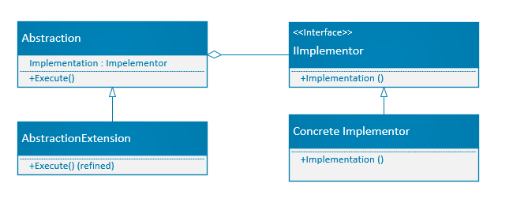
Gang of Four Definition
“Decouple and abstraction from its implementation so that the two can very independently”

Slide 155
Attributes of The Bridge Design Pattern
Abstraction
Abstraction Extension
Implementation Interface
Concrete Implementation

Slide 156
Benefits of a BRIDGE Design Pattern
Decouples Abstraction from Implementation
Improved Flexibility
Enhanced Scalability
Simplified Code Maintenance
Reduced Code Duplication

Slide 157
Down sides of THE Bridge Design Pattern
Increased Complexity
Additional Overhead (Performance)
Initial setup difficult
Learning Curve

Slide 158
Relationship to Solid
BRIDGE

Slide 159
BRIDGE pattern and S.O.L.I.D.
S. Separates the abstraction from implementation so each has a single responsibility.
O. This pattern supports decoupling the abstraction from implementation.
L. Abstraction and the implementation must be able to be used interchangabily
I. This is developer dependent to ensure ISP
D. Bridge is inherently dependency inversion. High level module (the abstraction) and the low level implementation both depend on an interface allowing both to vary independently.

Slide 160
Real World Scenarios
BRIDGE pattern

Slide 161
What are some Scenarios where The BRIDGE Pattern Might be Useful?

Slide 162
Scenarios where The BRIDGE pattern is often Used
Graphics Rendering Engines
Database Drivers
User Interface Frameworks
A Remote Control
Logging System

Slide 163
Implementation
BRIDGE Pattern

Slide 164
Implementing The Bridge Pattern in Code

Slide 165
OBSERVER Design Pattern
Look AT ME

Slide 166
OBSERVER problem space

Slide 167
What problems does OBSERVER Pattern Help Solve?
Multiple Object Instances of different types need to be able to communicate with each other.

Slide 168
OBSERVER Pattern Defined

Slide 169
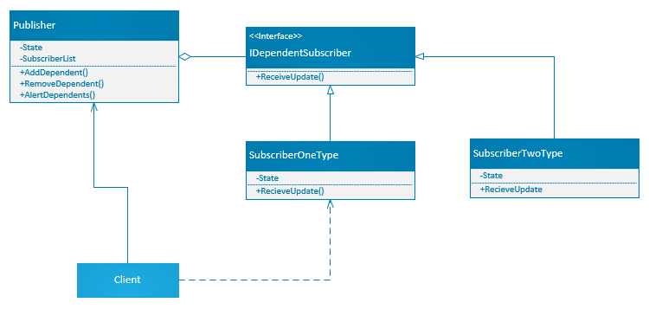
Gang of Four Definition
“Defines a one-to-many dependency between objects so that when one object changes state all its dependents are notified and updated automatically”

Slide 170
Attributes of THE OBSERVER Design Pattern
Subject / Publishers
Dependents / Subscribers

Slide 171
Benefits of a Observer Design Pattern
Relationship can be established or removed at runtime.
Decoupled behavior in clients.
Scalable across multiple clients
Increased maintainability

Slide 172
Down sides of The Observer Design Pattern
Increased Complexity
Synchronicity may be a problem
Unintended Consequences
Publisher is unaware of the state of observers but still hast to maintain reference

Slide 173
Relationship to Solid
OBSERVER

Slide 174
Observer pattern and S.O.L.I.D.
S. The responsibilities of notifying observers and how the observers respond is separated.
O. Observers do not depend on the Publisher. Observers are added to the publisher.
L. Observers have to comply with the interface but how they act based off of state change is up to the developer.
I. Observer interface should be simple. Just enough to establish itself as an observer.
D. Dependency inversion happens through a method rather than the constructor but it is there.

Slide 175
Real World Scenarios
OBSERVER pattern

Slide 176
What are some Scenarios where The OBSERVER Pattern Might be Useful?

Slide 177
Scenarios where The OBSERVER pattern is often Used
Real time data monitoring.
Notification systems
Distributed systems
Games (MMO)
Logging
Auditing

Slide 178
Implementation
OBSERVER Pattern

Slide 179
Implementing THE OBSERVER Pattern in Code

Slide 180
Iterator Design Pattern
Generic Lists FTW

Slide 181
Iterator problem space

Slide 182
What problems does Iterator Pattern Help Solve?
The ability to traverse a collection without knowing its underlying structure.

Slide 183
Iterator Pattern Defined

Slide 184
Gang of Four Definition
“Provide a way to access the elements of an aggregate object sequentially without exposing its underlying representation.”

Slide 185
Attributes of The Iterator Design Pattern
Iterator Interface
Concrete Iterator
Aggregate Interface
Concrete Aggregate

Slide 186
Benefits of a Iterator Design Pattern
Encapsulation of Aggregate
Consistency
Improved Functionality of Arrays
Safety

Slide 187

Down sides of THE Iterator Design Pattern
Likely Unnecessary in modern C#
Generics and Link to objects fill this roll very effectively.

Slide 188
Relationship to Solid
Iterator

Slide 189
BRIDGE pattern and S.O.L.I.D.
S. Separates Navigation from the actual collection
O. You can change both collection and navigation logic independently.
L. This is up to the developer but it does support using an interface encouraging this behavior.
I. Focuses the traversal logic in a simple interface.
D. Collection is separated from the traversal and does not depend on it.

Slide 190
Real World Scenarios
Iterator pattern

Slide 191
What are some Scenarios where The Iterator Pattern Might be Useful?

Slide 192
Scenarios where The Iterator pattern is often Used
File System Navigation
Database Results Sets
Social Media Feeds
Network packets

Slide 193
Implementation
Iterator Pattern

Slide 194
Implementing The Iterator Pattern in Code

Slide 195
Week 7
Proxy, Flyweight, Decorator, and Mediator

Slide 196
Proxy Design Pattern
Making Stuff act like other stuff

Slide 197
Proxy problem space

Slide 198
What problems does Proxy Pattern Help Solve?
Accessing complex backend logic from the presentation layer.
User Interface and backend are developed separately.

Slide 199
Proxy Pattern Defined

Slide 200
Definition
“Provide a surrogate or placeholder for another object to control access to it.”

Slide 201
Elements of a Proxy Design Pattern
Subject: The object called to request behavior.
Real Subject: The actual object that contains the data.
Proxy: The object that stands in place of the Real Subject.

Slide 202
Benefits of a Proxy Design Pattern
Can greatly reduce the amount of time high intensity processes take to return.
Helps control access
Allows Interchangeability
.

Slide 203
Down sides of A Proxy Design Pattern
Cache may be out of date.
Don’t really get the benefit if you update too frequently.

Slide 204
Relationship to Solid
Proxy

Slide 205
Proxy pattern and S.O.L.I.D.
S. Delegates the behavior of should we get data from the source of the data.
O. Proxies can be interchanged to function differently.
L. Proxies must be the same as the source or they don’t work.
I. Promotes the use of small specific interfaces to interact with big processes.
D. The proxy needs an interface injected to work with the real source.

Slide 206
Real World Scenarios
Proxy pattern

Slide 207
What are some Scenarios where The Proxy Pattern Might be Useful?

Slide 208
Scenarios where The Proxy pattern is often Used
Content Delivery Network (CDN)
Web Browsers
Secured Internet

Slide 209
Implementation
Proxy Pattern

Slide 210
Implementing a Proxy Pattern in Code

Slide 211
Flyweight Design Pattern

Slide 212
Flyweight problem space
Share the Stuff

Slide 213
What problems does Flyweight Pattern Help Solve?
Using many instances of an object while keeping code running Smoothly.

Slide 214
Flyweight Pattern Defined

Slide 215
Definition
“Use sharing to support large numbers of fine-grained objects efficently.”

Slide 216
Elements of a Flyweight Design Pattern
Flyweight Interface: represents the objects to be shared.
Concrete Flyweight: Implements and shares Intrinsic State
Flyweight Factory: Manages a pool of Flyweight objects in a way that maximizes reuse.
Client : The code that consumes and uses the flyweight

Slide 217
Benefits of a Flyweight Design Pattern
Smaller memory footprint
Update across common objects
.

Slide 218
Down sides of A Flyweight Design Pattern
Often Increased processer usage.
Everything is updated with the flyweight object as it pertains to that flyweight objects. They can not be individual.

Slide 219
Relationship to Solid
Flyweight

Slide 220
Flyweight pattern and S.O.L.I.D.
S. Separates intrinsic state across multiple objects from individual implementations.
O. You can extend with new flyweights without having to implement new clients.
L. Flyweights should be able to be used interchangeably
I. Promotes ISP by using small interfaces for groups of intrinsic information.
D. Use a factory to create objects.

Slide 221
Real World Scenarios
Flyweight pattern

Slide 222
What are some Scenarios where The Flyweight Pattern Might be Useful?

Slide 223
Scenarios where The Flyweight pattern is often Used
Real Time Strategy game.
Text fonts in text editors.
In GUI.

Slide 224
Implementation
Flyweight Pattern

Slide 225
Implementing a Flyweight Pattern in Code

Slide 226
Decorator Design Pattern
It is beginning to look a lot like Christmas

Slide 227
Decorator problem space

Slide 228
What problems does Decorator Pattern Help Solve?
Adding new functionality to existing objects that can not be modified.

Slide 229
Decorator Pattern Defined

Slide 230
Definition
“Attach additional responsibilities to an object dynamically. Decorators provide a flexible alternative to subclassing for extending functionality”

Slide 231
Elements of a Decorator Design Pattern
Component:
ConcreteComponet:
Decorator:
ConcreteDecorator:

Slide 232
Benefits of a Decorator Design Pattern
Flexible Alternative to Subclassing.
Runtime behavior Modification
Promotes composition over inheritance

Slide 233
Down sides of A Decorator Design Pattern
Increased Complexity
Ordering Decorators when you have a lot.
Harder to debug
Can violate Liskov Substitution Principle.
Can provide Dependency Injection Complexity
Overhead

Slide 234
Relationship to Solid
Decorator

Slide 235
Decorator pattern and S.O.L.I.D.
S. (SRP) Each decorator adds a specific piece of functionality keeping responsibilities focused and separated.
O. (OCP) Decorators allow you to extend the behavior without modifying the decorated classes’ code.
L. (LSP) Decorators typically implement the same interface as they wrap.
I. (ISP) Decorators allow adding functionality without bloating
D. (DIP) Decorators rely on injected interfaces rather than concrete implementations.

Slide 236
Real World Scenarios
Decorator pattern

Slide 237
What are some Scenarios where The Decorator Pattern Might be Useful?

Slide 238
Scenarios where The Decorator pattern is often Used
Stream Classes
Logging with Dependency Injection
Validation Code
Entity Framework (Interceptors)

Slide 239
Implementation
Decorator Pattern

Slide 240
Implementing a Decorator Pattern in Code

Slide 241
Mediator Design Pattern

Slide 242
Mediator problem space
Share the Stuff

Slide 243
What problems does Mediator Pattern Help Solve?
Multiple object instances of different types need to be able to communicate with each other.

Slide 244
Mediator Pattern Defined

Slide 245
Definition
“Define an object that encapsulates how a set of objects interact. Mediator promotes loose coupling by keeping objects from referring to each other explicitly and I lets you vary their interaction independently.”

Slide 246
Elements of a Mediator Design Pattern
Mediator Interface
Concrete Mediator
Colleague
Concrete Colleagues

Slide 247
Benefits of a Mediator Design Pattern
Reduces coupling between components.
Improves readability
Facilitates centralized control

Slide 248
Down sides of A mediator Design Pattern
Over-centralization god object.
Reduces component reusability.
Overhead

Slide 249
Relationship to Solid
Mediator

Slide 250
Mediator pattern and S.O.L.I.D.
S. (SRP) : Separates the communication between components
O. (OCP) : It allows you to add new components to change interaction logic by modifying or extending the mediator.
L. (LSP) : You can replace components in the mediator by adhering to the expected interface.
I. (ISP) : Everything communicates with the mediator through a narrow well-define interface.
D. (DIP) : This does decouple high level object from low-level implementation.

Slide 251
Real World Scenarios
Mediator pattern

Slide 252
What are some Scenarios where The mediator Pattern Might be Useful?

Slide 253
Scenarios where The Mediator pattern is often Used
Air Traffic Control
Chat Applications
UI coordination between controls.
MMO

Slide 254
Implementation
Mediator Pattern

Slide 255
Implementing a Mediator Pattern in Code

Slide 256
Command Design Pattern

Slide 257
Command problem space
Do different stuff in the Same Way

Slide 258
What problems does Command Pattern Help Solve?
The system is controlled by complex combinations of inputs.

Slide 259
Command Pattern Defined

Slide 260
Definition
“Encapsulate a request as an object, thereby letting you parameterize clients with different requests, queue or log requests, and support undoable operations.”

Slide 261
Elements of a Command Design Pattern
Command (Interface) : Interface that lets this function as a command. (Don’t use COMMAND name in C#)
Concrete Command :
Client : creates the command object and set’s its receiver.
Invoker : Asks the command to carry out the request.
Receiver : Knows how to perform the operations associated with carrying out the request.

Slide 262
Benefits of a Command Design Pattern
Decouples sender and reciever
Encapsulation of requests
Undo and Redo
Queuing.
Extensibility

Slide 263
Down sides of A Command Design Pattern
Increased code complexity.
Boilerplate Code.
Overhead
Increased Memory Usage.

Slide 264
Relationship to Solid
Command

Slide 265
Mediator pattern and S.O.L.I.D.
S. (SRP) : Commands encapsulate a single request and each piece has a single reponsiblity.
O. (OCP) : You can add commands without modifying existing code.
L. (LSP) : By implementing a common interface commands can fill this role.
I. (ISP) : The command object is minimal in that it provides just enough to run the command.
D. (DIP) : Invoker accepts Command Interface objects not specific command implementations.

Slide 266
Real World Scenarios
Command pattern

Slide 267
What are some Scenarios where The Command Pattern Might be Useful?

Slide 268
Scenarios where The Command pattern is often Used
Menus
Undo Redo
Macro Recording/Scripting
Test Automation
Game Development (Actions encapsulated as Commands)

Slide 269
Implementation
Command Pattern

Slide 270
Implementing a Command Pattern in Code

